Slide 1

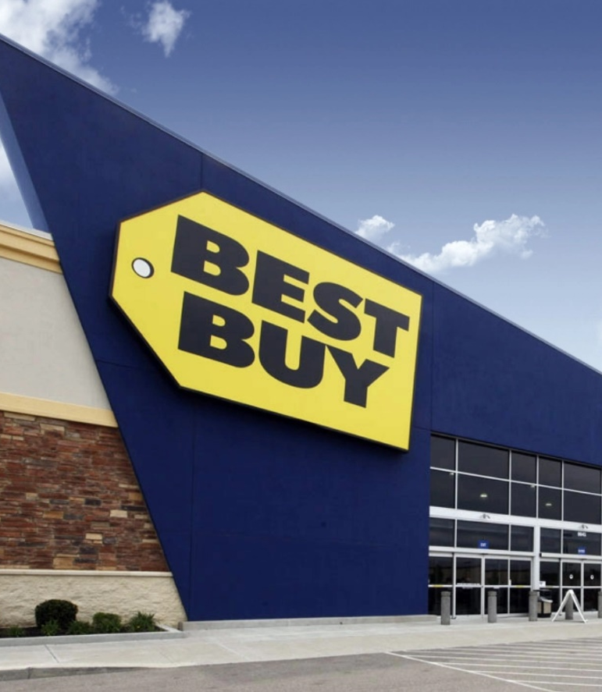
Web Scraping Project Best Buy Data Analysis: Refrigerator
By
Haining, Fu

Slide 2
Overview
Best Buy is the largest specialty retailer in the United States consumer electronics retail industry.
Founded by Richard M. Schulze and James Wheeler in 1966 as an audio specialty store called Sound of Music.
In 1983, it was re-branded under its current name with an emphasis placed on consumer electronics.

Slide 3
My Research
Best Buy is one of the largest kitchen appliance retailers throughout the US. I am curious about how brands, number of reviews, ratings and styles affect the refrigerators’ prices move. I used scrape to scrape all the information I need for every single refrigerator.
Method
To get the data on each product, I created a spider in scrapy, the spider will go through each result page which shows 24 products per page and go into individual product page to extract the data I needed. I extracted 1000+ products after the spider went through the loop.
For each refrigerator I found the following elements for my analysis:
Brand
Number of reviews
Ratings
Product description
Style
Questions
What’s the most important Element influence the variation of the price?
Prices vs brands?
Prices vs number of reviews?
Prices bs ratings?
Prices vs style?
Do higher number of reviews cause the lower ratings?

Slide 4
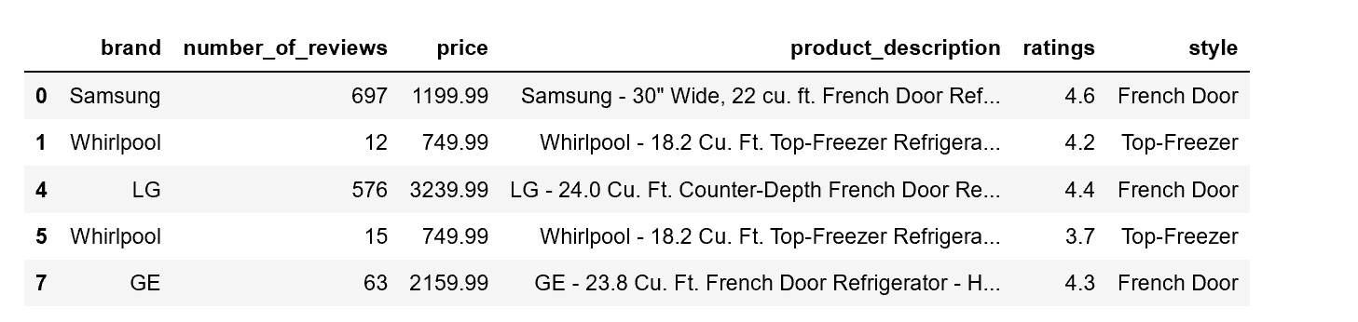
Data Cleaning
It took me a couple of hours to scrape all the data I needed. The majority of the raw data I grabbed from the websites is not in a workable form. Since I have a tremendous difficulty to grab the style category. I decided to extract the “style” column from the “product description”. See the screenshot below. product_description column contains many useful information, such as the style of each refrigerator. I created a new style column by using regular expression by filter through all the words. That probably is the biggest challenge through the entire cleaning process. After get the new style column, there were still many NaN value in different columns. Dropna is the method to filter through all the data. Eventually I retrieved a completed workable form data. However, the number of rows reduced to 662 rows
Result Table

Slide 5
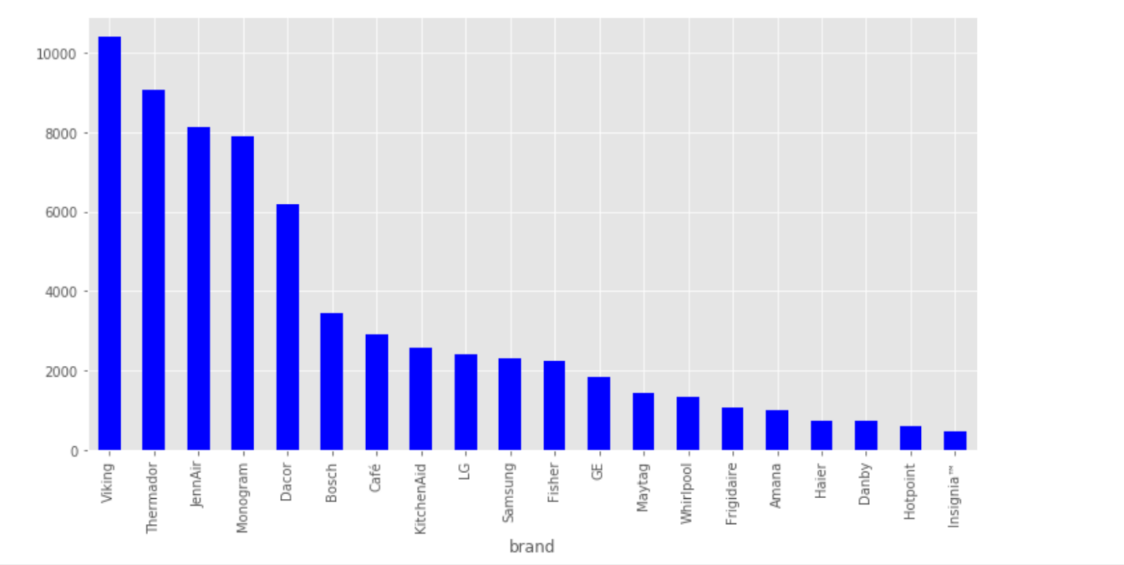
Conclusion
1.) Check the relationship between brand and price by visualizing those 2 variables.
Brand has a significant impact on the price variation.
For example. “Viking” only manufactures customized high-end refrigerators.
Most of price for “Viking” are over $10,000. Therefore, brand is key factor influence the prices.

Slide 6
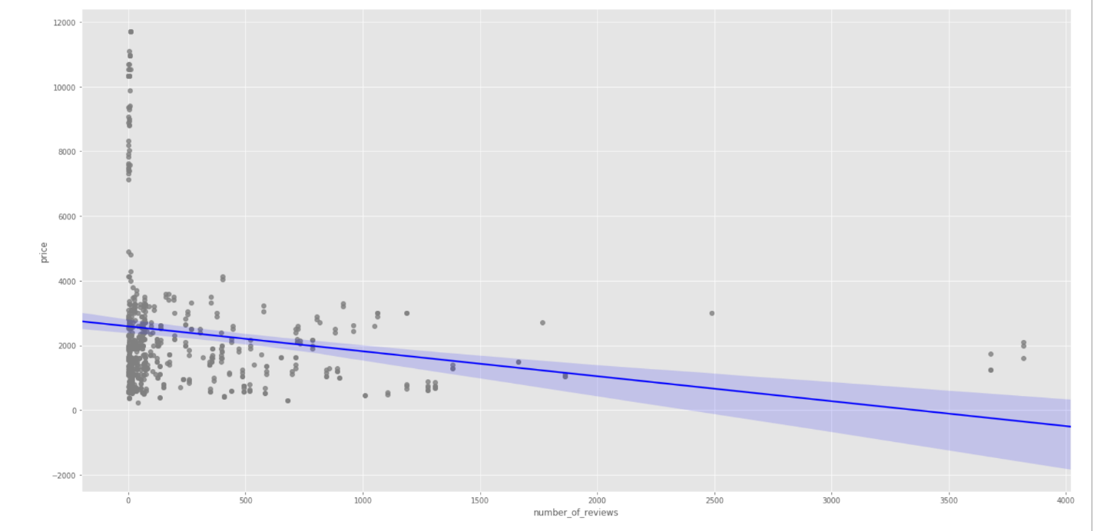
Conclusion
2.) Relationship between number of reviews and prices.
The price and number of reviews has an inverse relationship.
Less reviews on a product have higher price of the product.
Not necessarily true that the variation of the prices is based on the number of reviews.

Slide 7
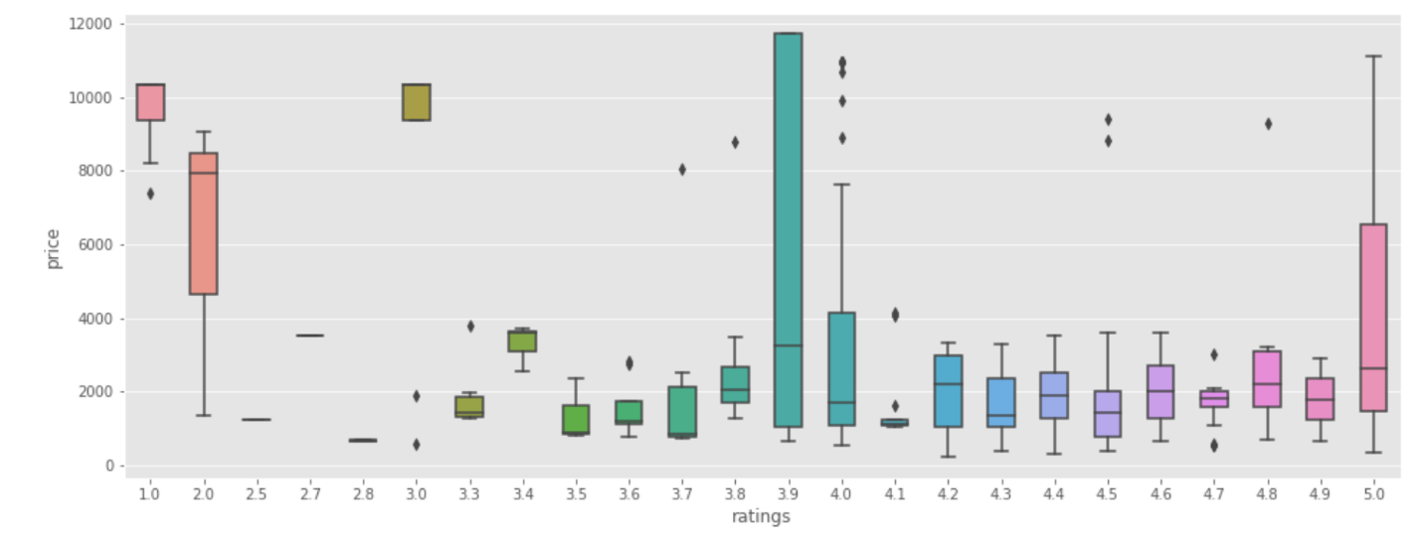
Conclusion
3.) Relationship between ratings and prices
No relationship between ratings and prices.
Ratings will not affect the price range for each product.

Slide 8
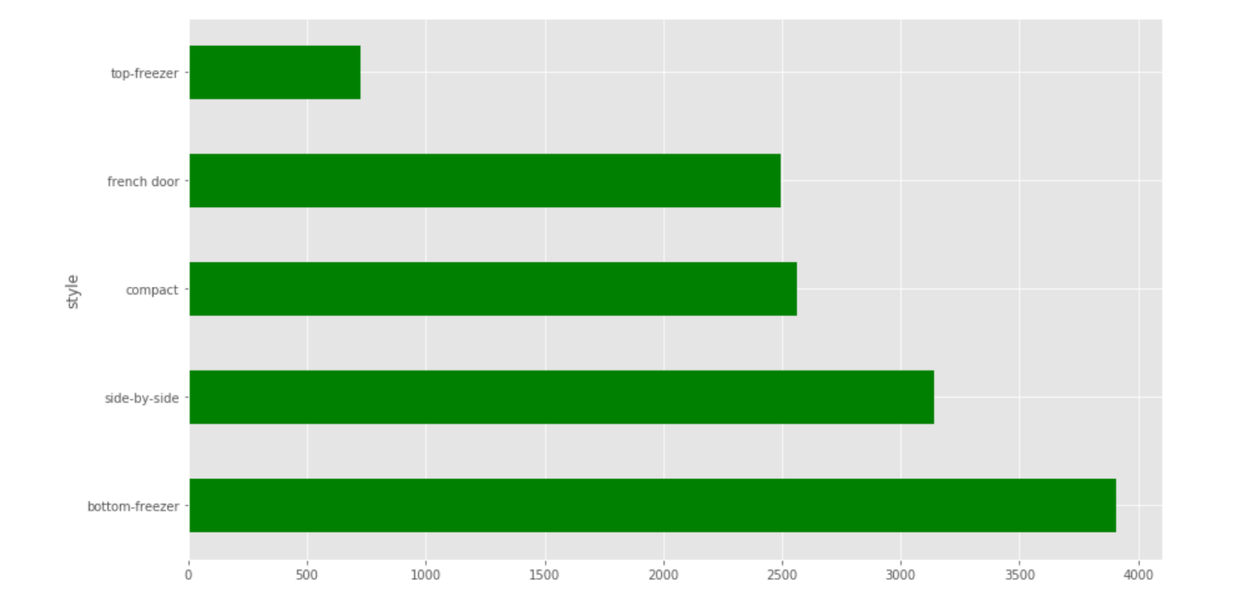
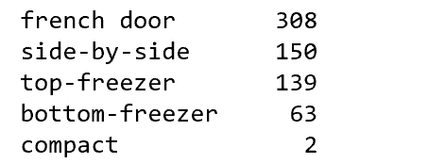
Conclusion
4.) Relationship between style and price
the website. Therefore we cannot conclude that any relationship between the price and style.
As we can see on the graph, with different styles, we do see prices are increasing, however, the graph on the right shows us the sample size of each different style. Average prices of compact style are more than $2,500, but only 2 samples are provided through the website. Therefore we cannot conclude that any relationship between the price and style.

Slide 9
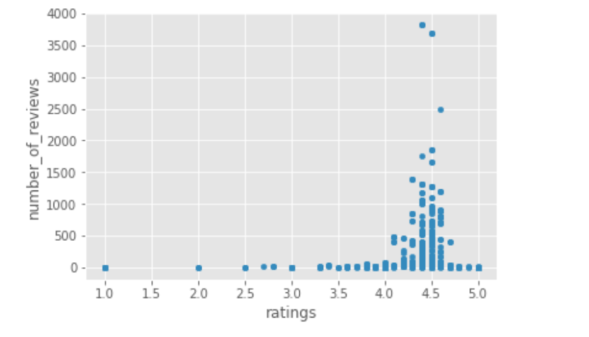
Do higher number of reviews cause the lower ratings?

Slide 10

As showed on the graph, we can see the ratings and number of reviews shows a positive relationship. Therefore the assumption is incorrect.

Slide 11

Suggestions for the prospect refrigerator buyers if you want to purchase it from Best Buy
Brand is the most crucial factor affect the prices for you to select the most ideal refrigerator

Slide 12
Future Work
Time is limited for us, with more time, I would like to have a deeper understanding about my data, I would love to scrape more data such as “total capacity”, “freezer capacity” etc. I believe that with more categorical data, I can have a deeper and solid conclusion. It would be interesting to scrape all the refrigerator data from PcRichard website by using selenium. And compare both my analysis.

Slide 13
ANY QUESTIONS?
Thank you for your patience

